Slide 1
Does Climate Change Exist in Worcester?
Jade Zhang
Yan Shi
Jiamei Wang
Aditya Katheeth
Vishvendra Hudda

Slide 2
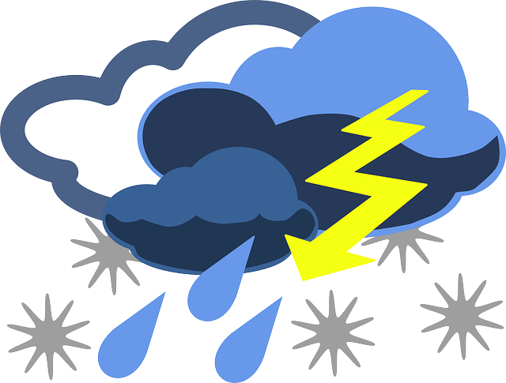
Business Problem
Weather Insurance
Insurance against weather variations
Two types:
Conditional weather insurance
An organization can run a promotion advertising up to a 100% rebate on all items purchased during a designated promotional period if a particular type and/or volume of weather occurs on a specific day
Weather cancellation insurance
Weather cancellation insurance reduces an organization’s risk in planning an outdoor event.
Weather cancellation insurance ensures that if inclement weather does occur, the organization will not lose their investment. Instead, an insurance company will cover those costs based on the size and type of the weather cancellation insurance purchased.
How should insurance company adjust the price/policy for weather insurance due to climate change in the predictable future?

Slide 3
What is Climate Change and Why it Matters
Climate change is a change in the usual weather found in a place. This could be a change in how much rain a place usually gets in a year. Or it could be a change in a place's usual temperature for a month or season.
The Climate Emergency we currently face requires adequate and immediate action. It is one of the most pervasive and threatening crises of our time.

Slide 4
Climate Change Signals we Analyzed
Temperature
Extreme weather

Slide 5
Research Questions
Is the trend of temperature changing over years?
Is it possible for us to predict the future temperature?
Does extreme weather become more frequent?
Is it possible for us to predict extreme weather?

Slide 6

1. Temperature in Worcester
Data visualization
Pearson correlation and linear regression
ARIMA and SARIMA

Slide 7
Data Cleaning & Preparation
Drop
Drop or replace missing values
Label
Label data in day, month, season and index
Group
Group data in month
Group
Group data in season

Slide 8
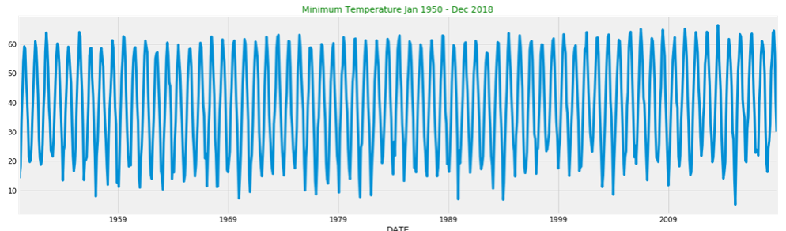
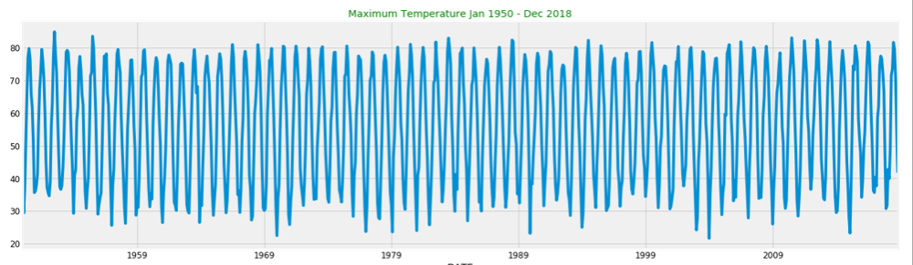
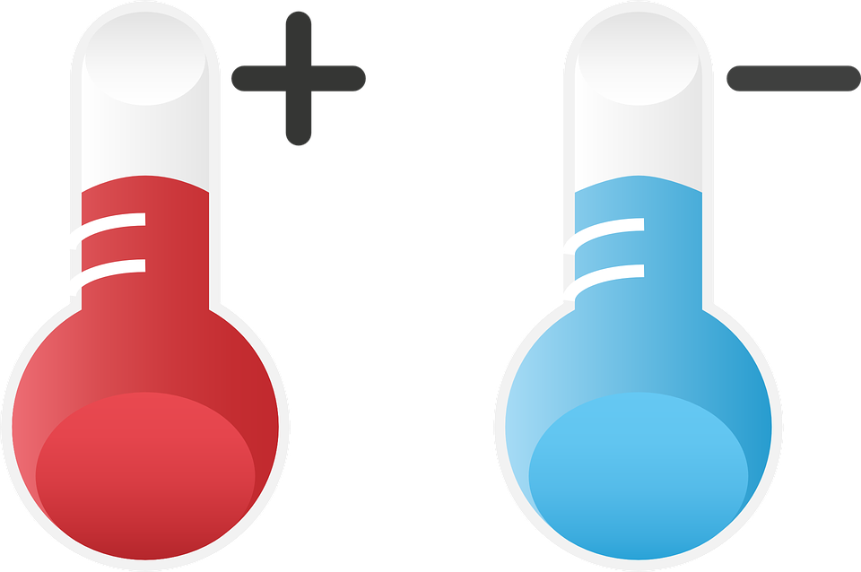
Data Visualization for Temperature over 50 Years

Slide 9
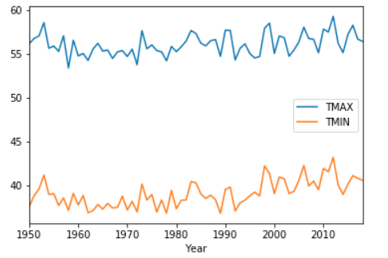
Mean Temperature over 50 years
It seems like the trend is not very obvious...
How about group it by season and month?

Slide 10
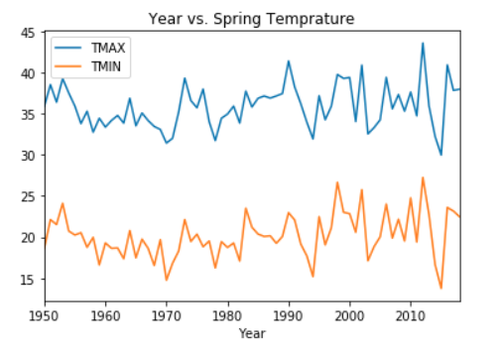
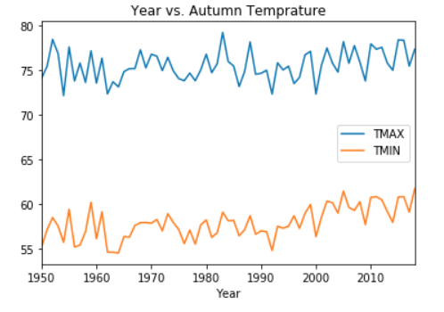
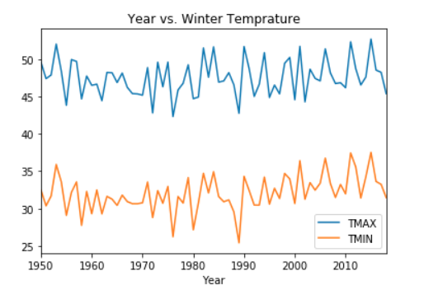
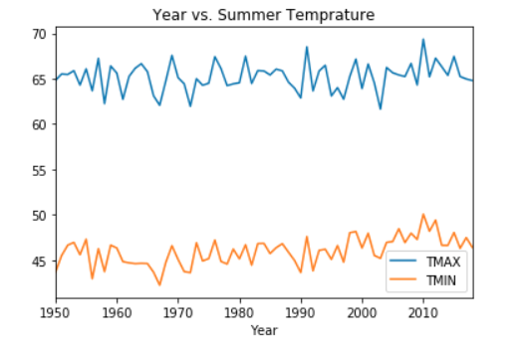
Average Seasonal Temperature Visualization Over 50 Years

Slide 11
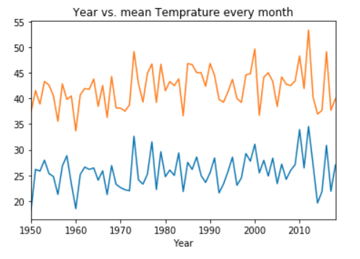
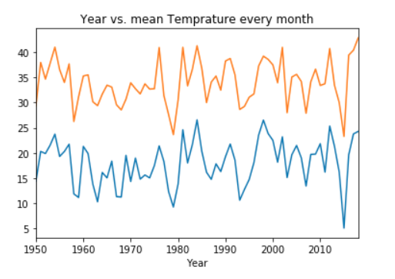
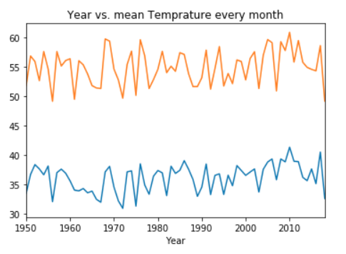
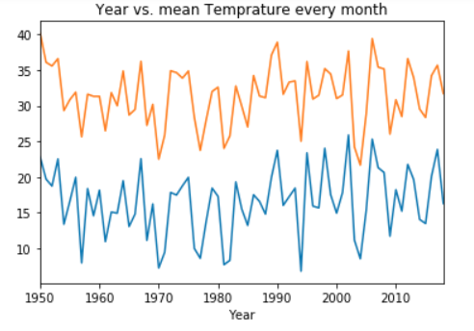
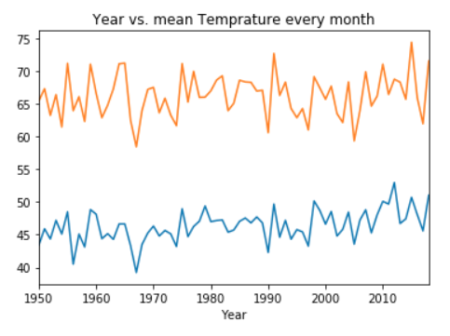
Average Monthly Temperature Visualization Over 50 Years
Uhhhhh too many graphs...
Conclusions from Visualization:
Nonstationary (parameters such as mean and variance change over time)
Seasonal
And 7 more plots...

Slide 12
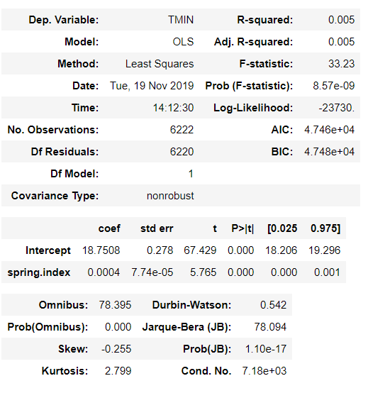
Pearson correlation & Linear Regression
Pearson correlation
Linear Regression
We also tried to test more specific data (such as the mean temperatures of the first week in every January), but the performance is still bad.
This data does NOT fit linear regression model

Slide 13
Two Models used in Temperature Prediction
ARIMA
SARIMA
Autoregressive Integrated Moving Average (ARIMA)
Seasonal Autoregressive Integrated Moving Average (SARIMA)

Slide 14
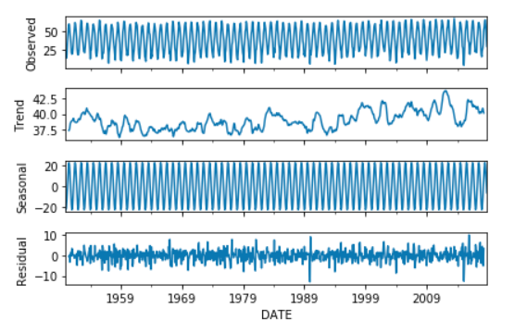
Data Decomposition
The trend exists?
But the further research is required

Slide 15
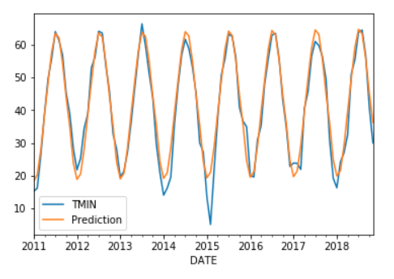
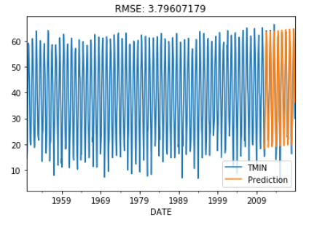
Arima Model A classical analysis model dealing with non-stationary time series data to either better understand the data set or to predict future trends.
Train Set: 1950 - 2010
Test Set: 2011-2018
Root Mean Square Error (RMSE)

Slide 16
An Attempt to Improve Our Model Accuracy
A problem with ARIMA is that it does not designed for seasonal data.
An extension to ARIMA that supports the direct modeling of the seasonal component of the series is called SARIMA.

Slide 17
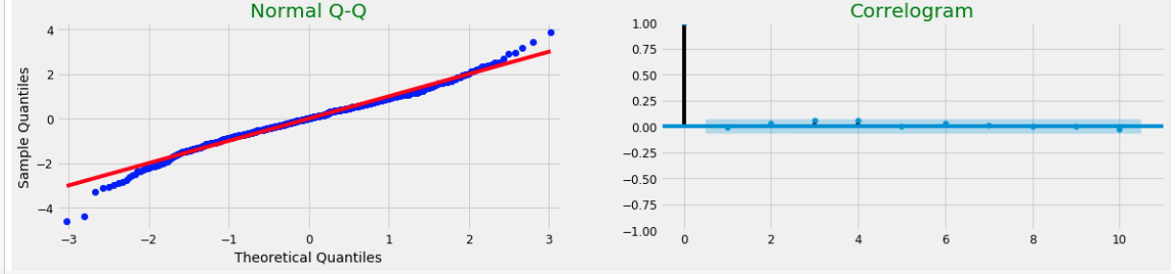
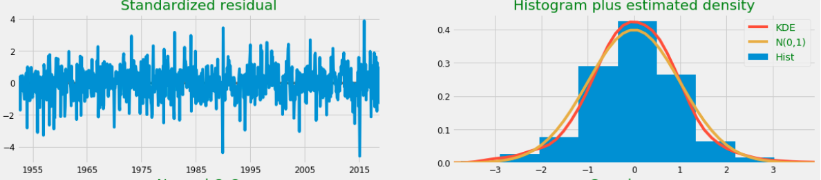
Model Validation Check
Residuals are approximately normal distributed
Correlation is small, thus data is random

Slide 18
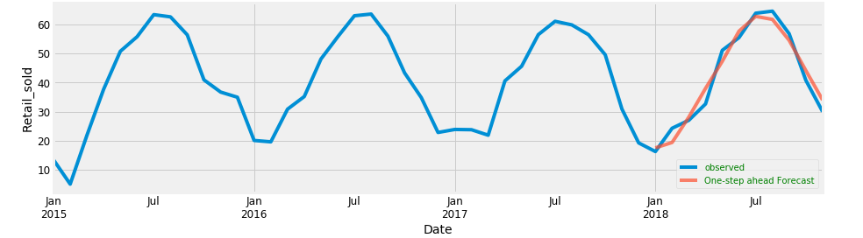

SARIMA Model Sarima is an extension of ARIMA that explicitly supports univariate time series data with a seasonal component.
The data we used to fit the model is the minimum temperature. The maximum temperature provides similar results

Slide 19
2. Extreme Weather in Worcester
Data visualization
Prediction using machine learning models

Slide 20
Data cleaning and preprocessing
Drop or replace the missing values
Define extreme weather variable
Make extreme weather a dummy variable
Normalize numeric variables in range (0,1)

Slide 21
Concepts
How did we define extreme weather?
Heavy fog, thunder, hail, high winds, freezing, snow, and ice pellets
What are the independent variables?
Precipitation
Snowfall
Minimum temperature
Maximum temperature

Slide 22
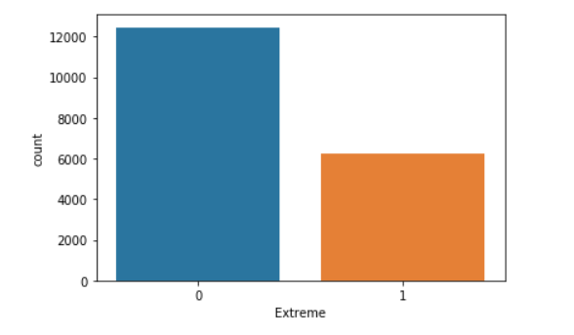
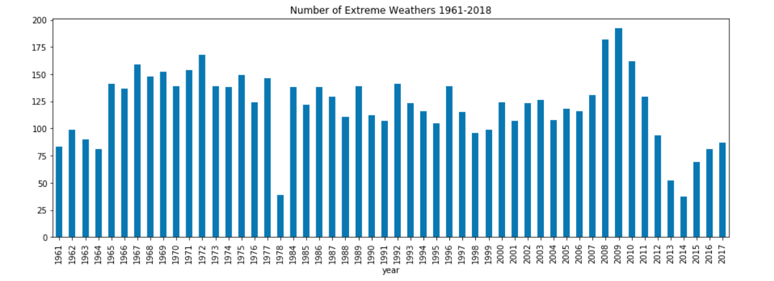
Visualization of Extreme Weather
Total counts for 1960-2017
The histogram for every year

Slide 23
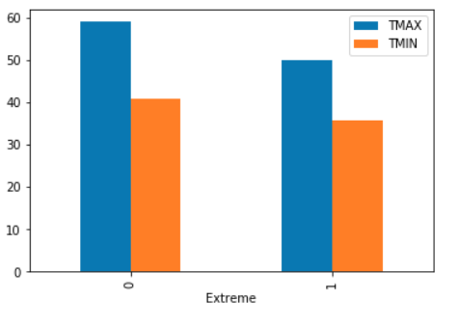
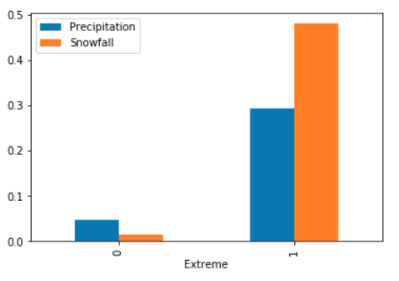
Check the Relationship

Slide 24
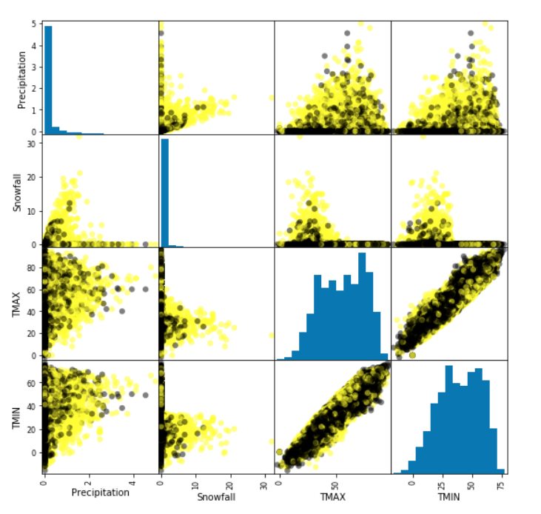
Check the Relationship
Minimum Temperature and Maximum temperature are highly correlated
Precipitation and snowfall are positively correlated to extreme weather
Temperatures might be weakly correlated to extreme weather

Slide 25
Predicting extreme weather
Gaussian Naive Bayes model
Logistic Regression
K-Nearest Neighbors
Random Forest
Support Vector Machine

Slide 26
Model Performance
Model | Accuracy on Training Set | Accuracy on Test Set | Accuracy with Cross Validation (5 folds)
Support Vector Machine | 0.74 | 0.73 | 0.75
Logistic Regression | 0.75 | 0.76 | 0.76
K-Nearest Neighbors | 0.82 | 0.77 | 0.74
Gaussian Naïve Bayes | 0.73 | 0.74 | 0.73
Random Forest | 0.86 | 0.79 | 0.78

Slide 27
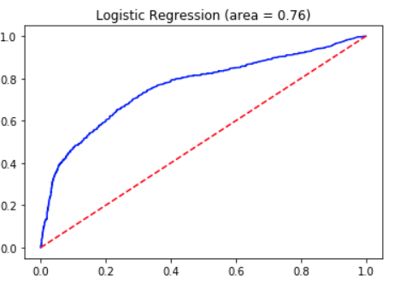
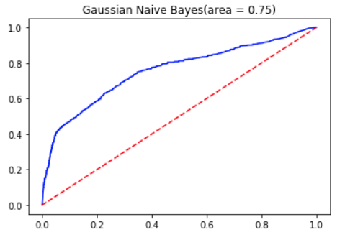
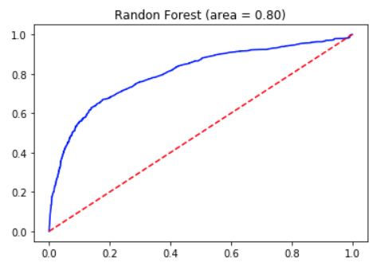



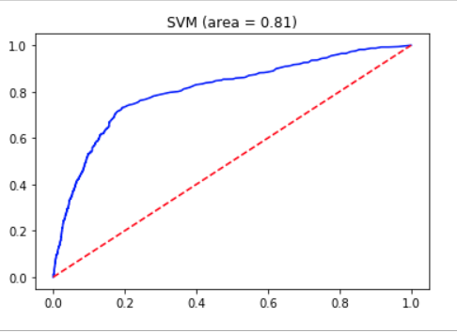

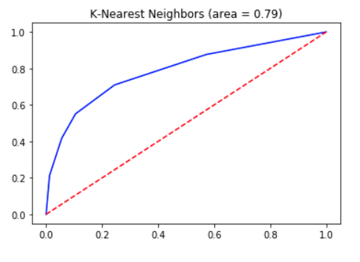

Visualization of the Performance

Slide 28
Conclusion
There is no significant change of the temperature in worcester, but the trend of which has slightly increased over 50 years
There is no obvious change of the number of extreme weathers due to time over 50 years
It is possible to predict the future temperature using classic models
It is possible to predict the future extreme weather by temperature, precipitation, and snowfall using machine learning models

Slide 29
Possible Improvements
Try other classic models and Neural Networks to see if it is possible to get more accurate prediction
Use larger dataset for machine learning models to improve the accurancy
Apply Neural Networks for classification problem
Find more independent variables
Adjust parameters
...

Slide 30
What should we do?
Consume
Consume less, waste less, enjoy life more
Use
Use energy wisely — and save money too
Eat
Eat for a climate-stable planet
Start
Start a climate conversation
Green
Green your commute

